Slide 1
COMPUTER NETWORKS
SESSION 04
IP Addressing Practice classful
Santoso Budijono

Slide 2
Learning outcomes
LO 2: Explain basic concepts of network
LO 3: Design network environment using TCP/IP Model

Slide 3
Outline
Class of IP
Type IP Address
MASK
Network Address
Broadcast Address
Gateway Address

Slide 4
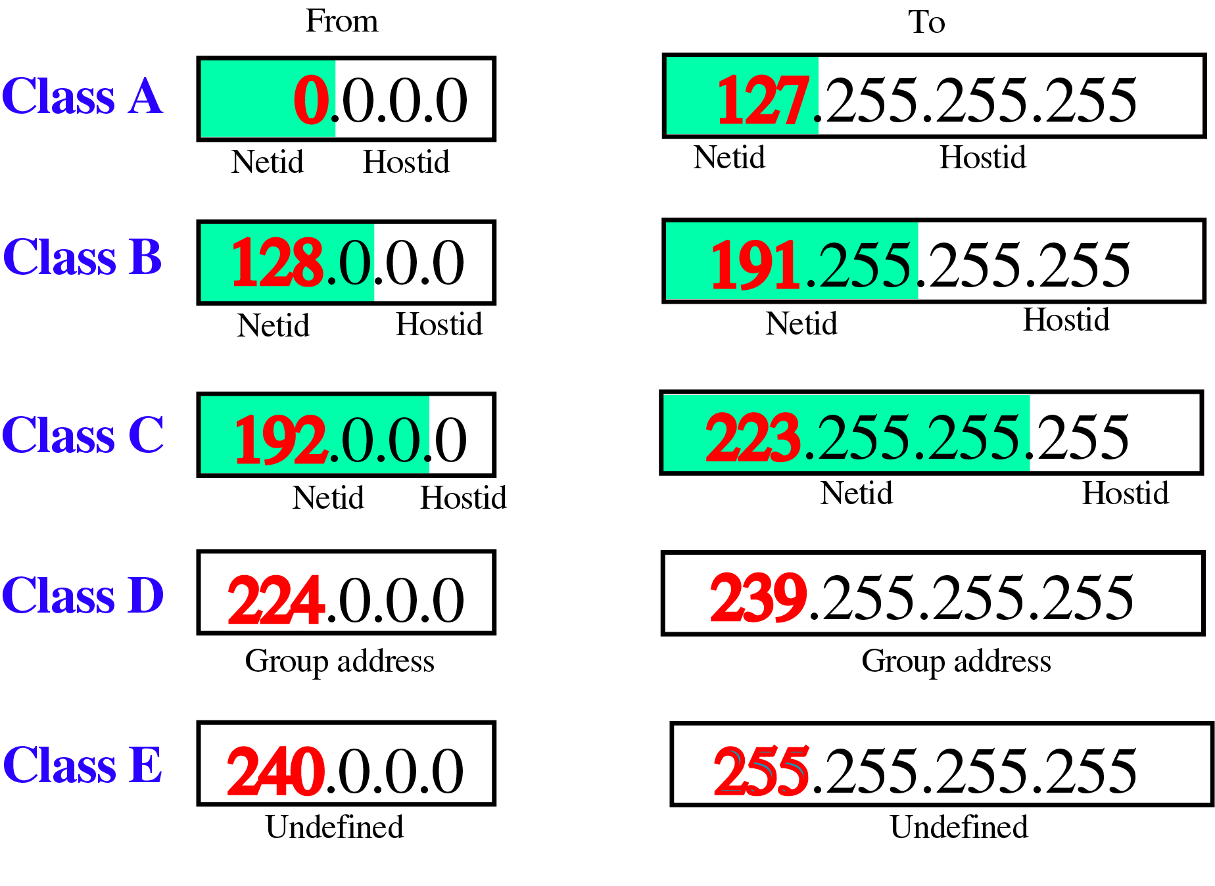
Class of ip
CLASSFUL ADDRESSING (A, B, C, D, E)
CLASSLESS ADDRESSING using CIDR
/8
/16
/24
Classful addressing – 1 group of network can not be divided into smaller networks
Classless addressing – 1 group of network can be divided into smaller networks

Slide 5
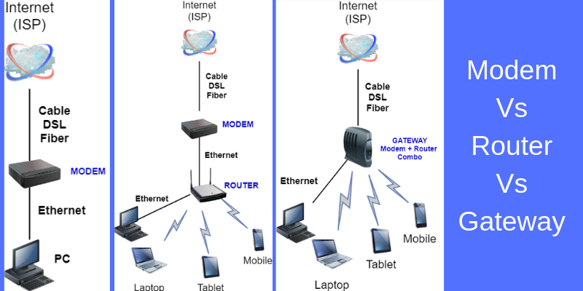
Type of ip address
Private IP Address
  Used for LAN
Public IP Address
  Used for WAN / Internet
NAT
  Translate a Private IP Address to a Public IP Address
  Typically implemented on Router
Devices
  Router is device that connects two networks
  Modem (stand for modulator-demodulator) is device that translate one type signal to other type signal. (Fiber optic from ISP to home router)
https://www.tech21century.com/modem-vs-router-vs-gateway/

Slide 6
addressing
Address mask
Address Mask / Net Mask / Subnet Mask
The address mask is a 32-bit number in which the n leftmost bits are set to 1s and the rest of the bits (32 − n) are set to 0s. A computer can easily find the address mask because it is the complement of (2^{32−n} −1). The reason for defining a mask in this way is that it can be used by a computer program to extract the information in a block, using the three bitwise operations NOT, AND, and OR.
The reason for defining a mask in this way is that it can be used by a computer program to extract the information in a block, using the three bitwise operations NOT, AND, and OR.
  The number of addresses in the block N = NOT (Mask) + 1.
  The first address in the block (Network Address) = (Any address in the block) AND (Mask).
  The last address in the block (Broadcast Address) = (Any address in the block) OR [(NOT (Mask)].

Slide 7
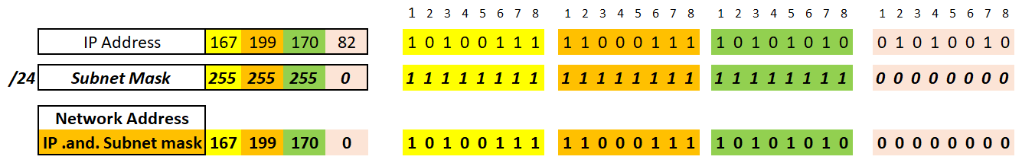
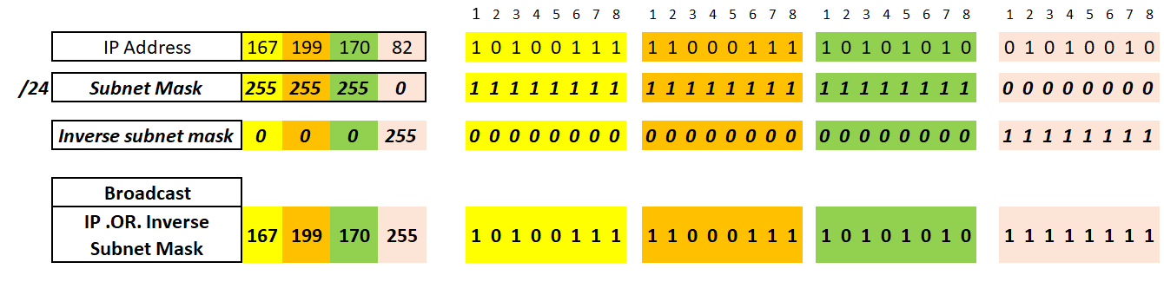
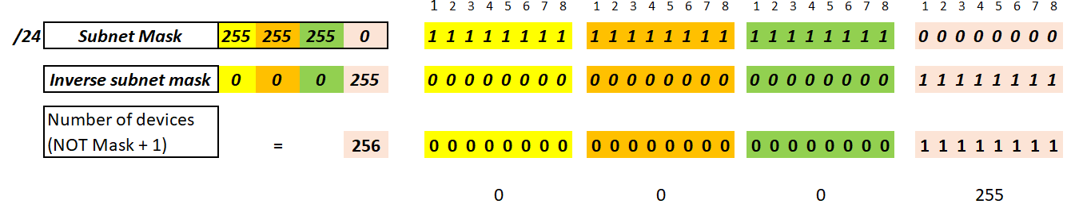
addressing
practice
IP address of devices 167.199.170.82 with subnet mask 255.255.255.0 or 167.199.170.82 /24
Find :
Network Address
Broadcast Address
Number of IP for this group
Answer :
a. Network Address
b. Broadcast Address
c. Number of IP at group
Or 2^8 = 256

Slide 8
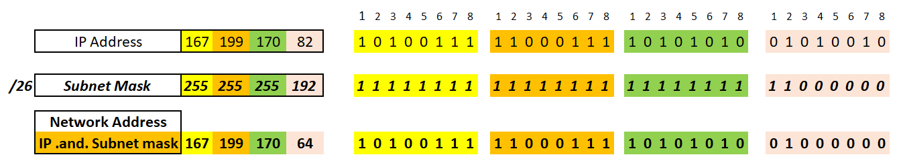
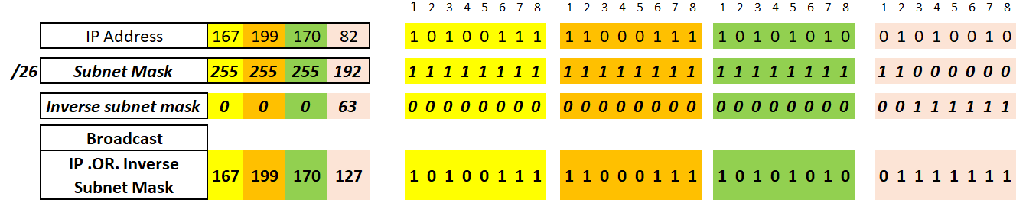
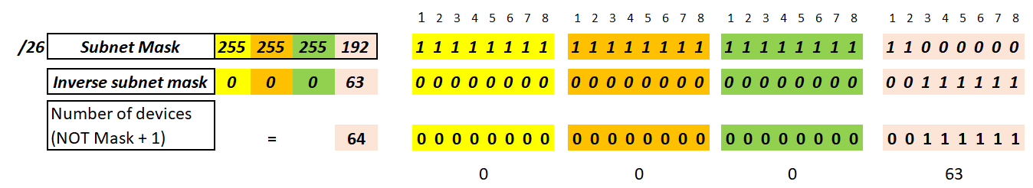
addressing
practice
IP address of devices 167.199.170.82 with subnet mask 255.255.255.192 or 167.199.170.82 /26
Find :
Network Address
Broadcast Address
Number of IP for this group
Answer :
a. Network Address
b. Broadcast Address
c. Number of IP at group
Or 2^6 = 64

Slide 9
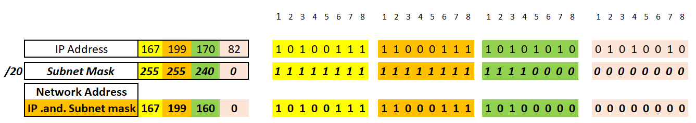
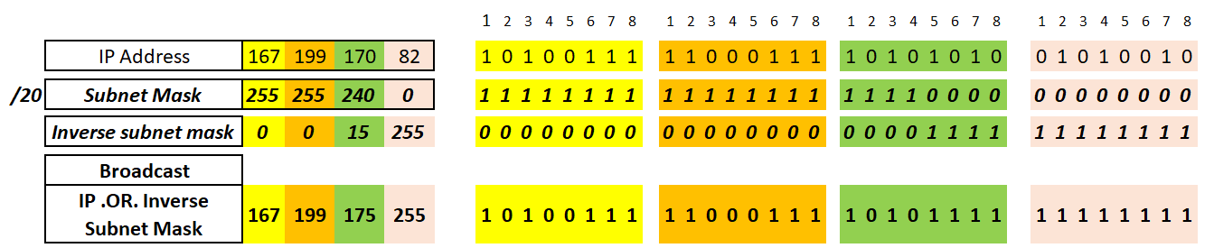
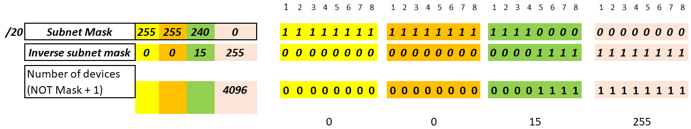
addressing
practice
IP address of devices 167.199.170.82 with subnet mask 255.255.240.0 or 167.199.170.82 /20
Find :
Network Address
Broadcast Address
Number of IP for this group
Answer :
a. Network Address
b. Broadcast Address
c. Number of IP at group
Or 2^12 = 4096

Slide 10
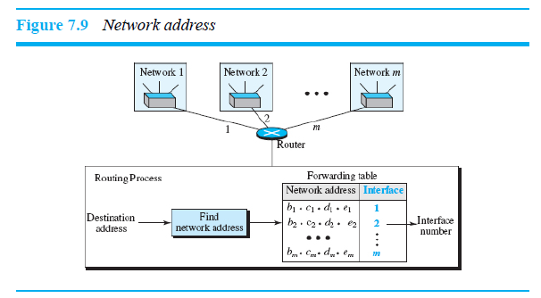
Ussed of ip Addressing
Network address
Network Address is used for routing a packet to its destination network.
Source IP : 167.199.170.82 /24 → calculated Network address : 167.199.170.0
Dest IP : 167.199.179.82 /24 → calculated Network address : 167.199.179.0
Network Address source different with Network Address destination, to forward packet from source (167.199.170.82 /24) to destination (167.199.179.82 /24) will used Router
Router will forward Packet to other network address using Routing table (forwarding table) via Interface Number
Interface 1, 2, 3 at router act as gateway for Network1, Network2, Network3

Slide 11
Used of Ip addressing
Broadcast address
Broadcasting means one-to-all communication. A frame with a destination broadcast address is sent to all entities in the link
Broadcast address always the highest number possible in a network or sub-network.
Some protocol used broadcast to send frame to all entities like ARP, RIP, etc.

Slide 12
Used of ip addressing
Number of ip
Number of IP in a group does not mean all IP can applied to all devices
IP of network address can not apply to devices because it used for routing purpose
IP of Broadcast address also can not apply to .
So numbers of IP that can be apply to device will be minus 2 from total IP at those network.

Slide 13
excercise
Find Network Address, Broadcast Address and total number of IP reserved for devices for this IP address shown below :
192.168.10.100 /24
18.20.220.100 /8
160.80.90.100 /16
192.168.10.100 /28

Slide 14
References
Forouzan, B. A. (2021). Data Communications and Networking with TCP/IP Protocol Suite. 6th Ed. New York: McGraw-Hill. ISBN: 978-1-26-436335-3. Chapter 7.

Slide 15
Thank you
December 2024

